Slide 1
Restaurant Review Dataset Based Sentimental Analysis with Machine Learning Approach
Submitted in the partial fulfillment for the award of the degree of
BACHELOR OF ENGINEERING
IN
Artificial Intelligence and Machine Learning
Submitted by:
M.L.K.SUBRAHMANYAM G.SAI PRASANTH
21BCS8803 20BCS6832 K.PRAKASH T.BHAGEERATH
21BCS8824 20BCS6380
Under the Supervision of:
MR. SIDDHARTH KUMAR
Department of AIT-CSE
DISCOVER . LEARN . EMPOWER

Slide 2
Outline
Introduction to Project
Problem Formulation
Objectives of the work
Methodology used
Results and Outputs
Conclusion
Future Scope
References

Slide 3
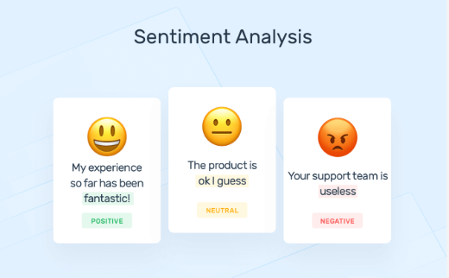
Introduction to Project
Sentiment Analysis is the way toward deciding if a portion of writing is negative or positive. This piece of writing could be a tweet, review about a book, film, movie, restaurant and so on. The sentiment analysis is also known as opinion mining, in which the opinions, appraisals, emotions or attitude towards a topic, person or entity are analyzed.
The expressions can be classified as positive or negative. For example. “I really liked the garlic noodles of your restaurant “- this is a positive expression. The overall sentiment polarity shows a preference on service in the reviews, which might hint the customers to “self -select” the food they like.

Slide 4
Natural language processing in artificial intelligence applications makes it easy to gather product reviews from a website and understand what consumers are actually saying as well as their sentiment in reference to a specific product. Companies with a large volume of reviews can actually understand them and use the data collected to recommend new products or services based on customer preferences.
Sentiment analysis helps identify customers' perceptions towards a brand, including tone, context, and emotions, and is equally beneficial for both consumers and service providers.
Customers find it helpful to read reviews from other customers to form an overall opinion about the product, while service providers can use this analysis to identify areas for improvement.
Using sentiment analysis, the overall result about the 2 opinions and views can be obtained within seconds. It not only gives the owners an idea about the consumers, but it also gives them a better picture of how they stack up against their competitors’ company.
Restaurant reviews are still in the form of text, customer reviews are included in the text mining category, the results of these data will be classified into two values, positive or negative.

Slide 5
Problem Formulation
Problem Statement: The objective of this project is to develop a machine learning-based sentimental analysis model that can analyze a dataset of restaurant reviews and accurately classify them into positive and negative categories.
The model will be trained on a large dataset of restaurant reviews and will use various natural language processing techniques to accurately analyze the sentiment of the reviews.
Dataset: The project will utilize a large dataset of Restaurant Reviews with both positive and negative reviews. The dataset will be divided into training, validation, and testing sets.
The data is stored into the database where each food item consists of number of customers, number of positive reviews, number of negative reviews, positive rate and negative rate. Now, the owner checks the least positively rated food item from the database, and takes necessary quality measurements which involve replacement of chefs or updating the ingredients used etc.

Slide 6
Objectives of the Work
The objective of this project is to conduct a comprehensive analysis of restaurant reviews using sentiment analysis techniques to identify the sentiment expressed by customers towards different aspects of the restaurant, such as food quality, service, ambiance, and value for money.
The study aims to compare the performance of different sentiment analysis algorithms and evaluate their accuracy in detecting different levels of sentiment, such as positive and negative sentiments.
Additionally, the research aims to investigate the impact of various factors, such as demographics, location, and restaurant type, on the sentiment expressed by customers in their reviews.
Furthermore, the report aims to provide actionable insights and recommendations to restaurant owners and managers based on the analysis of the sentiment expressed by customers.

Slide 7
Methodology used
Data Collection
In this step data is taken out from Kaggle in a recognized format. Missing fields are evacuated in this process & thus the data is transformed. Sentiment Analysis can be considered a classification process.
Data Pre-processing
The collected raw data of restaurant reviews consist of large number of attributes and there will be missing values. The reducing the attributes is required, extracting the attributes is also much essential.
Sentiment Analysis
The reviews sources are mainly review sites. Sentiment analysis is not only applied on product reviews but can also applied on stock market, news articles, or political debates.
Classification
The lexicon-based approach is to finding the opinion mining which is used to analyze or to predict the text. There are two methods in this approach.

Slide 8
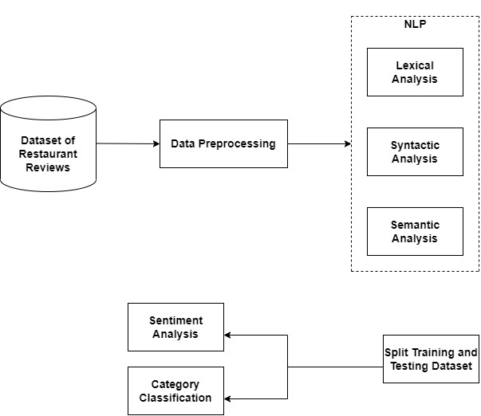
Architecture diagram of our research framework.

Slide 9
Comparison of results based on parameters
PARAMETERS | SVC | SVC + CountVect | Multinomial NB | MultinomialNB + CountVect
Precision | 86.6 | 80.08 | 73.6 | 83.7
Recall | 56.3 | 77.7 | 78.6 | 79.6
F1-score | 68.2 | 79.2 | 76.1 | 81.6
Accuracy | 73.02 | 79.05 | 74.5 | 81.5

Slide 10
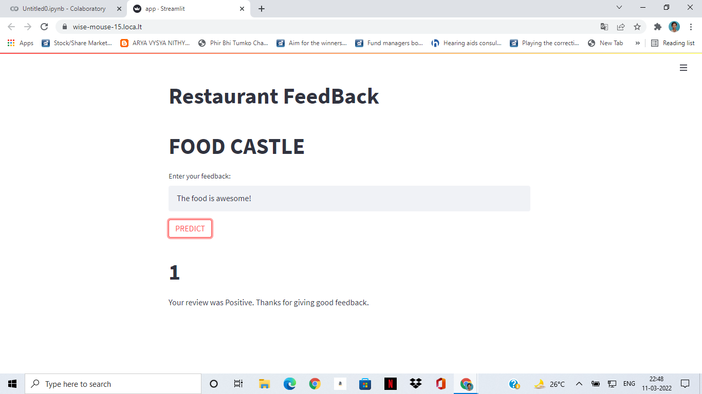
Results and Outputs
Prediction of User review (Positive)

Slide 11
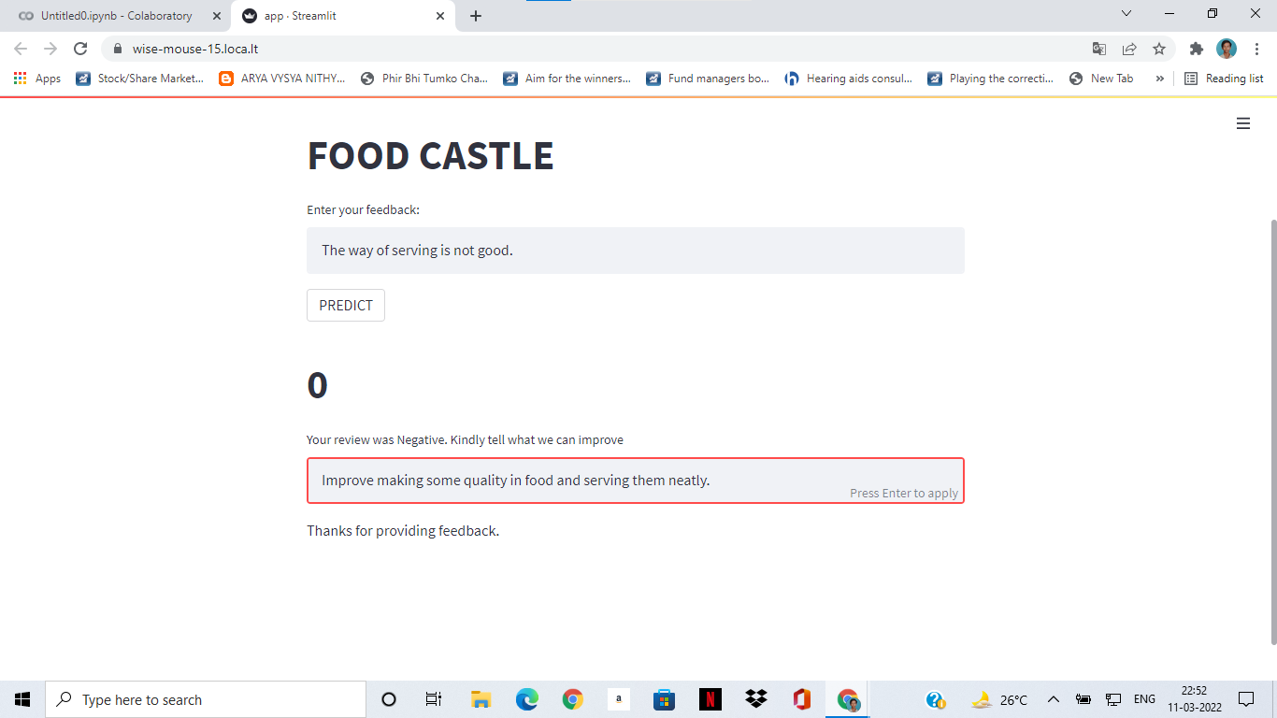
Prediction of User review (Negative)

Slide 12
Conclusion
Sentiment analysis is a powerful tool that can be used to analyze customer reviews and feedback for restaurants. By using natural language processing techniques, we can extract valuable insights from unstructured data and gain a deeper understanding of customer sentiment towards a restaurant.
Through the analysis of restaurant reviews, we can identify areas where the restaurant is performing well and areas where improvement is needed. By addressing these areas of improvement, restaurants can improve the overall customer experience and increase customer satisfaction.
In addition, sentiment analysis can also help restaurants identify trends and patterns in customer feedback, which can be used to make data-driven decisions and improve business operations.
Overall, sentiment analysis is a valuable tool for restaurants that want to better understand their customers and improve their business. By leveraging the power of natural language processing, restaurants can gain a competitive advantage and provide a better dining experience for their customers.

Slide 13
Future Scope
The future scope of brain detection with segmentation is promising as there are several potential applications and advancements in this field. Here are a few possible future developments:
Improved Accuracy
Faster Processing
Real-time Analysis
Image and Video Analysis
By implementing these improvements, sentiment analysis can become even more effective and provide restaurants with a deeper understanding of customer sentiment, allowing them to improve their business and provide a better dining experience for their customers.

Slide 14
References
M. Govindarajan, “Sentiment Analysis of Restaurant Reviews Using Hybrid Classification Model,” IRF International Conference, 2014.
D. V. N. Devi, C.K. Kumar and S. Prasasd “A feature Based Approach for Sentiment Analysis by Using Support Vector Machine”.
Y. Woldemariam, “Sentiment analysis in a cross-media analysis framework,” Hangzhou, 2016.
E. Boiv and M. F. Moens, “A machine learning approach to sentiment analysis in multilingual Web texts,” Belgium: Springer- Information Retrieval Journals, 2008.
A.B. Pawar, M.A. Jawale and D.N. Kyatanavar, “Fundamentals of Sentiment Analysis: Concepts and Methodology”, An Environment of Computation Intelligence, Springer International Publishing Switzerland 2016, pp. 25-35.
Peter Koncz and Jan Paralic, “An approach to feature selection for sentiment analysis”, 15th International Conference on Intelligent Engineering Systems, June 23 –25, 2011, Poprad, Slovakia.

